Slide 1
Separators
Monica Linnell
Kelley, Joe

Slide 2
What do separators do?
Vertical or Horizontal lines in menus or panels
Dividing line or empty space

Slide 3
Using separators
JPanel buttonPane = new JPanel();
buttonPane.setLayout(new BoxLayout(buttonPane,
BoxLayout.LINE_AXIS));
buttonPane.add(fireButton);
buttonPane.add(Box.createHorizontalStrut(5));
buttonPane.add(new JSeparator(SwingConstants.VERTICAL));
buttonPane.add(Box.createHorizontalStrut(5));
buttonPane.add(employeeName);
buttonPane.add(hireButton);
buttonPane.setBorder(BorderFactory.createEmptyBorder(5,5,5,5));
import javax.swing.JSeparator;
menu.add(menuItem1);
menu.add(menuItem2);
menu.add(menuItem3);
menu.addSeparator();
menu.add(rbMenuItem1);
menu.add(rbMenuItem2);
menu.addSeparator();
menu.add(cbMenuItem1);
menu.add(cbMenuItem2);
menu.addSeparator();
menu.add(submenu);

Slide 4
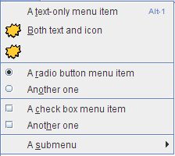
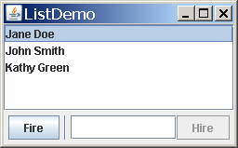
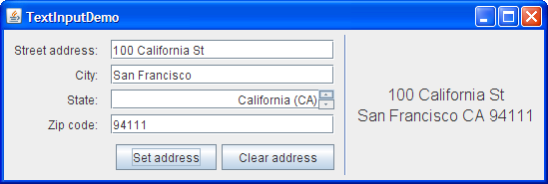
Why Use Them?

Slide 5
Works Cited
"How to Use Separators." (The Java™ Tutorials Creating a GUI With JFC/Swing Using Swing Components). Oracle. Web. 12 Sept. 2014.
"JSeparator (Java Platform SE 8 )." JSeparator (Java Platform SE 8 ). Web. 12 Sept. 2014.

Slide 6
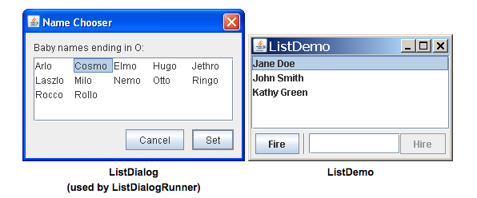
LISTS -- Presenting a group of items, displayed in one or more columns
Models
Example Panels
DefaultListModel
AbstractListModel
ListModel
http://docs.oracle.com/javase/tutorial/uiswing/components/list.html

Slide 7

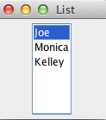
Sample Code
public ListExample()
{
exampleDefaultModel = new DefaultListModel();
exampleDefaultModel.addElement("Joe");
exampleDefaultModel.addElement("Monica");
exampleDefaultModel.addElement("Kelley");
exampleJList = new JList(exampleDefaultModel);
exampleJList.setSelectedIndex(0);
exampleJList.setVisibleRowCount(10);
JScrollPane listScrollPane = new JScrollPane(exampleJList);
add(listScrollPane, BorderLayout.CENTER);
}

Slide 8
Applications
High tech grocery list for high tech families
Business list to impress your boss
To Do lists
The list goes on and on…

Slide 9
Spinners
Joe Miloshevsky

Slide 10
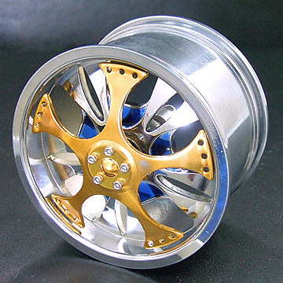
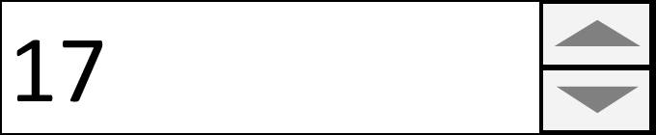
What is a Spinner?
Swing Component/GUI
A fancy type of textbox
Up and down arrows for scrolling
Keyboard arrow buttons
Does not “cycle” by default
Your IQ:

Slide 11
Declaration and Invocation
SpinnerModel numModel =
new SpinnerNumberModel(12, 0, 52, 1);
//(initial, min, max, increment)
JLabel label = new JLabel(labelName);
SpinnerDemo.add(label);
JSpinner spinner1 = new JSpinner(numModel);
label.setLabelFor(spinner1);
SpinnerDemo.add(spinner1);

Slide 12
Obvious Reasons to Use Spinners
1 Scroll through a list
2 Auto-fill
3 Makes GUI look more complicated than it actually is
Ex:
VS
17
17

Slide 13
Sources
http://docs.oracle.com/javase/tutorial/java/index.html
http://www.ebay.com/itm/4-Wheel-Spinner-Fit-T-Maxx-Revo-MGT-HPI-Savage-21-25-BG-/360390090313

