Slide 1
Menus and Progress Bars
Joey Erlandson and Alex Blue

Slide 2
What is a menu?
In computing, a menu is typically a dropdown with several options and tasks that can be chosen
Menus are usually hierarchically organized
They can allow access to multiple levels of a menu
An example is the File, Home, or Insert menu in several Microsoft Office applications

Slide 3
Menu in Java
Declaration:
menuBar = new JMenuBar();
menu = new JMenu("Menu");
Invocation:
frame.setJMenuBar(demo.createMenuBar());

Slide 4
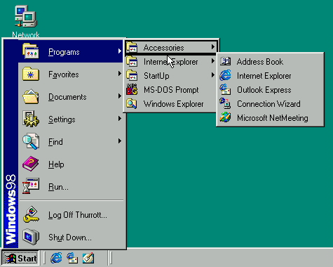
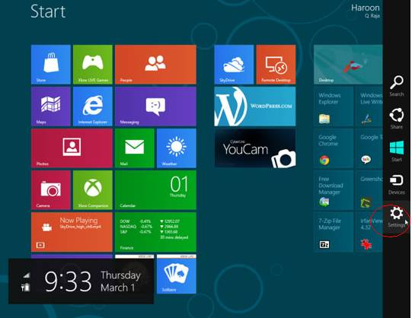
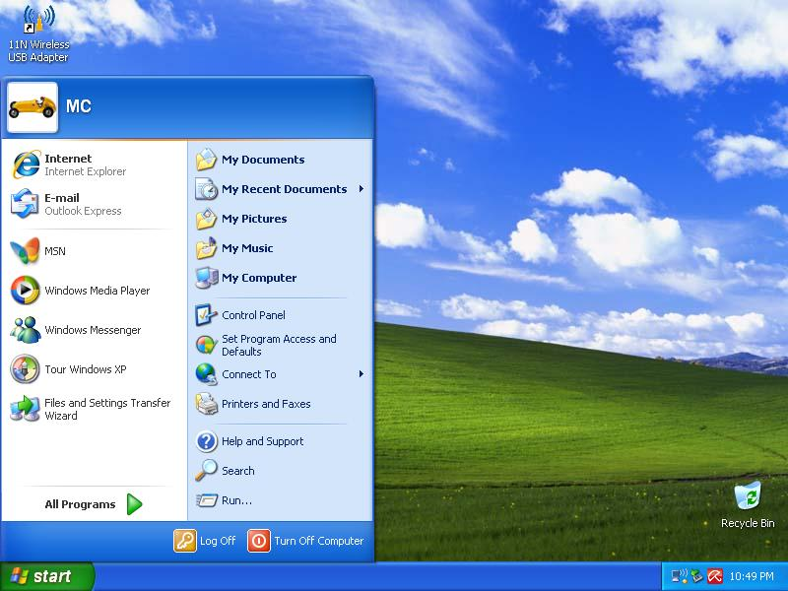
Change in Menus over time (Windows)
Windows XP
Windows 98
Windows 8

Slide 5
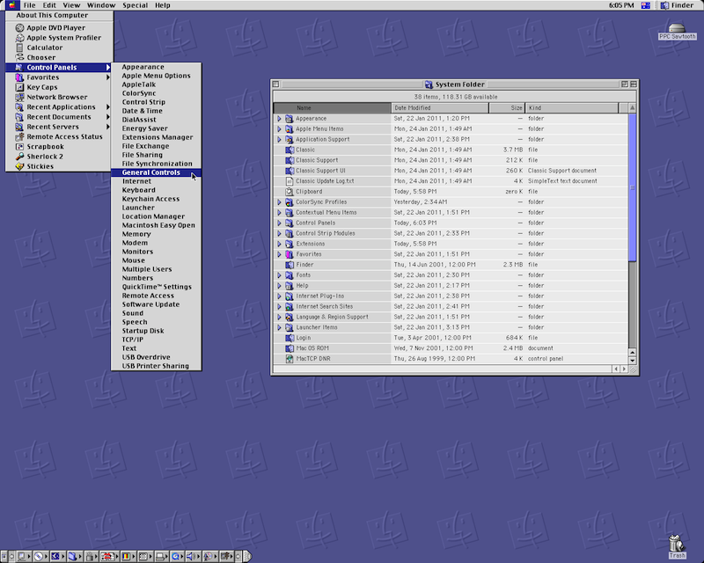
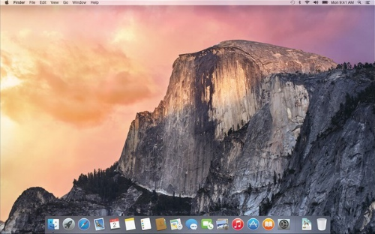
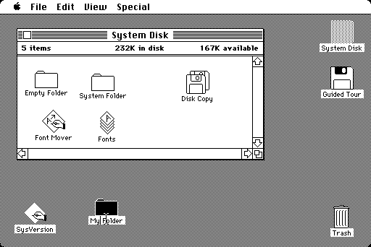
Change in Menus over time (Mac)
Upcoming OS X v10.10
Yosemite
Original Macintosh
Mac OS 9

Slide 6
What is a progress bar?
A progress bar is a tool for a computer user to see the progress of a computer operation that is currently under task
There are several different forms of progress indicators, like bars, shapes, lines, and other ways that show gradual progress
Some examples of progress bars are in copying and deleting files, loading bars in video games, and saving progress

Slide 7
Progress Bar in Java
Declaration:
progressBar = new JProgressBar(0, 100);
Invocation:
ProgMenu demo = new ProgMenu();

Slide 8
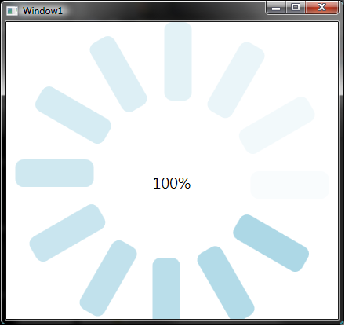
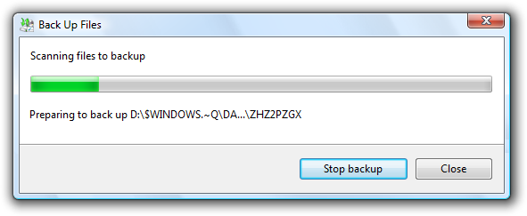
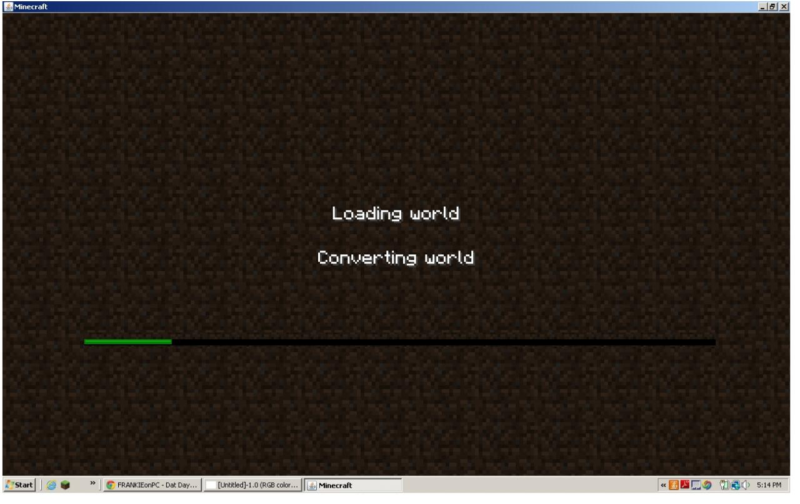
Examples of Progress Bars

Slide 9
References:
http://en.wikipedia.org/wiki/Menu_(computing)
http://en.wikipedia.org/wiki/Progress_bar
http://docs.oracle.com/javase/tutorial/displayCode.html?code=http://docs.oracle.com/javase/tutorial/uiswing/examples/components/MenuDemoProject/src/components/MenuDemo.java
http://docs.oracle.com/javase/tutorial/displayCode.html?code=http://docs.oracle.com/javase/tutorial/uiswing/examples/components/ProgressBarDemoProject/src/components/ProgressBarDemo.java

