Slide 1
Labels and Dialogs
Rachel Kurtz and Steve Frank

Slide 2
What Labels do
Displays unselectable text and images
If you want an interactive component, use a button instead

Slide 3
Labels
ImageIcon icon = new ImageIcon(“computer.png”;
//Create the first label
label1 = new JLabel("Image and Text”, icon, JLabel.CENTER);
//Set the position of the text, relative to the icon:
label1.setVerticalTextPosition(JLabel.BOTTOM);
label1.setHorizontalTextPosition(JLabel.CENTER);
//Create the others
label2 = new JLabel("Text-Only Label");
label3 = new JLabel(icon);

Slide 4
Reasons to use Labels
Display a string or image
Simplifies forms

Slide 5
What Dialogs do
Allow you to navigate a menu
Gives visual options
Has different options for usage

Slide 6
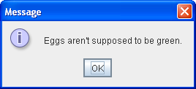
Dialogs
JOptionPane.showMessageDialog(frame, "Eggs are not supposed to be green.");
By using JOptionPane, you can quickly create several different kinds of dialogs

Slide 7
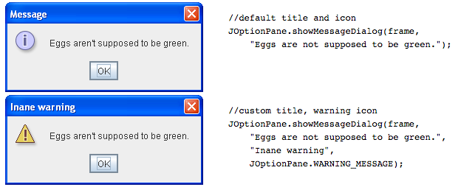
Various Simple Dialogs

Slide 8
Reasons to use a Dialog
To carry temporary notices
  Error messages or warnings to users
Has many different styles to fit your needs

