Slide 1
Image Icon
Mike Mulhearn & Drew Hobbs

Slide 2
Overview
Paints icons from images
Images can be JPEG, JPG, GIF, PNG, BMP, WBMP
Images may also be created from a URL, filename or byte array
  Must first be preloaded using Media Tracker to monitor loaded state of image
Function can be pass numerous images at once and a string description

Slide 3
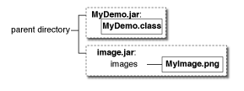

File storage
Data usually comes from an image file
Files can be stored in multiple ways
Images are in one Java Archive and the class file is in a separate Java Archive
Class file and images are stored in the same Java Archive
Images courtesy of The Java Tutorial at: http://docs.oracle.com/javase/tutorial/uiswing/components/icon.html

