Slide 1
File IO
By Rachel Thompson and Michael Deck

Slide 2
The Basics
Java.io- a package for input and output
File I/O
  Reads data into and out of the console
  Writes and reads files, etc.
  Involves streams, paths, files, directories, etc.

Slide 3
I/O Streams
Streams
  Sequences of data (can handle many different kinds)
  I/O Streams- reference input source or output destination
  Must be closed after use
Types
  Byte streams
  Character streams
  Buffered Streams
  Data streams
  Object streams
  Etc.

Slide 4
Specific Streams
For Output
  FileOutputStream- outputs bytes
  FileWriter- outputs characters and strings
  BufferedWriter- more efficient character writer
For Input
  FileInputStream
  FileReader
  BufferedReader
  Scanner- allows user input, parses tokens when reading, small buffer

Slide 5
Creating and Reading Files
Like with streams, you can create files in a variety of ways.
  File file = new File(c:\file.txt);
You can likewise read in a file’s content with the different input streams, and output it from the console with the output streams.
Note: exceptions
  E.g.: “file already exists”, permissions error, corrupted file, etc.
  Will cause your program not to compile unless checked
  Throw exception, then try your main code, and add a catch in case the exception occurs

Slide 6
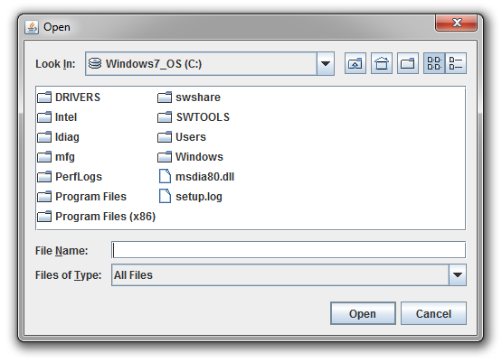
Other Things to Know
Directories
  Files.createDirectories (Paths.get (“workspace\test”));
JFileChooser
  Lets user select a file to read in
  Displays an open menu

Slide 7
Works Cited
"Lesson: Basic I/O." (The Java™ Tutorials Essential Classes). Docs.oracle. Oracle, n.d. Web. 20 Sept. 2013. <http://docs.oracle.com/javase/tutorial/essential/io/index.html>.
"JFileChooser (Java Platform SE 7 )." Docs.oracle. Oracle, n.d. Web. 23 Sept. 2013. <http://docs.oracle.com/javase/7/docs/api/javax/swing/JFileChooser.html>.

